Slide 1



Slide 2

QUANTUM SOFTWARE DEVELOPMENT

Slide 3


Slide 4

FABIANA 🚀 CAMPANARI
GABREL SANTOS
PEDRO VYCTOR ALMEIDA

Slide 5

ANALYSIS OF VALUE ADDED
AND ITS DISTRIBUTION IN BOVESPA BANKS
Stats tests anova
2024

Slide 6
Study Motivation
Objective: Study the generation and distribution of wealth among different groups in listed banks.
Description: Introduction to DVA and its importance for transparency and socioeconomic policies.
Stats tests anova
2024

Slide 7
Study Motivation
Key Points:
- Relevance of corporate transparency.
- Importance of fair wealth distribution.
- Evolution of corporate social and environmental responsibility concept.
Stats tests anova
2024

Slide 8
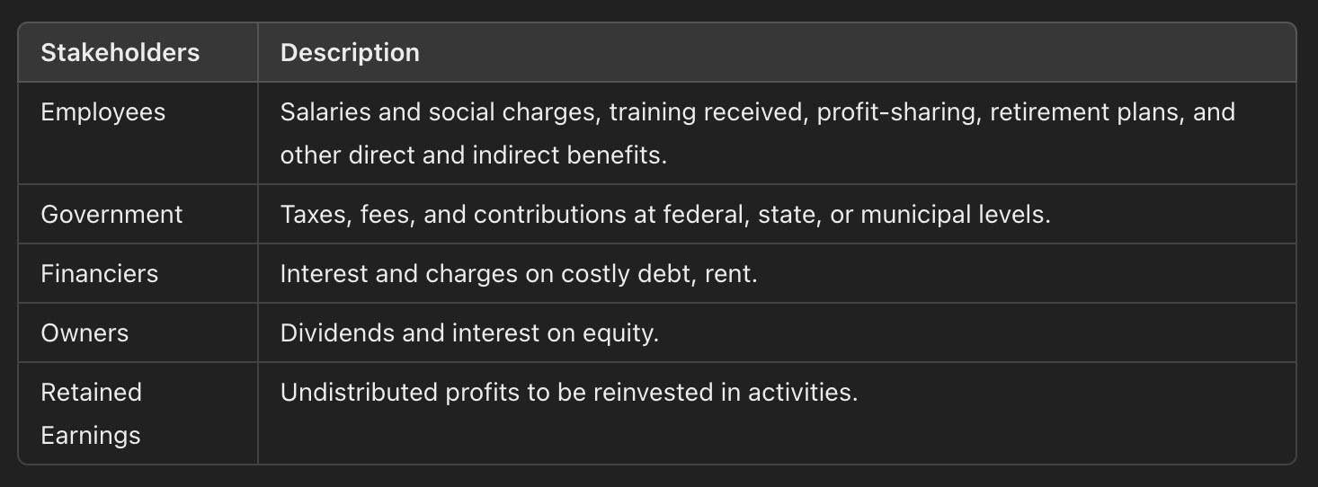
Study Motivation
Tabela 1 - Stakeholders Classification
Stats tests anova
2024

Slide 9
Research Methodology
- Description: Quantitative research with statistical analysis using ANOVA and Levene's test.
- Test Objectives:
- Verify the equality of value-added means among studied banks.
- Hypotheses: H0 (equal means) and H1 (significant differences).
Stats tests anova
2024

Slide 10

Research Methodology
Table 2: Banks that did not participate in the research (including reasons for exclusion)
Stats tests anova
2024

Slide 11
Research Data
- Levene's F Test (less than 5%): not all variances of all banks are equal.
- Figure 1: Itaú, Banco do Brasil, Bradesco, and Santander account for 85% of the added value of all banks.
- Figure 2: HSBC, Citibank, Banrisul, and Nordeste stand out compared to others, which have a median below R$ 1 million.
Stats tests anova
2024

Slide 12
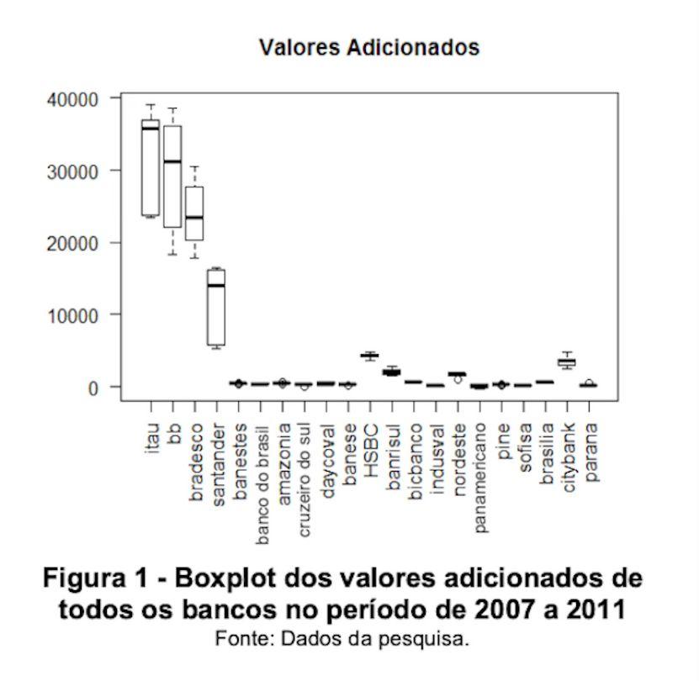
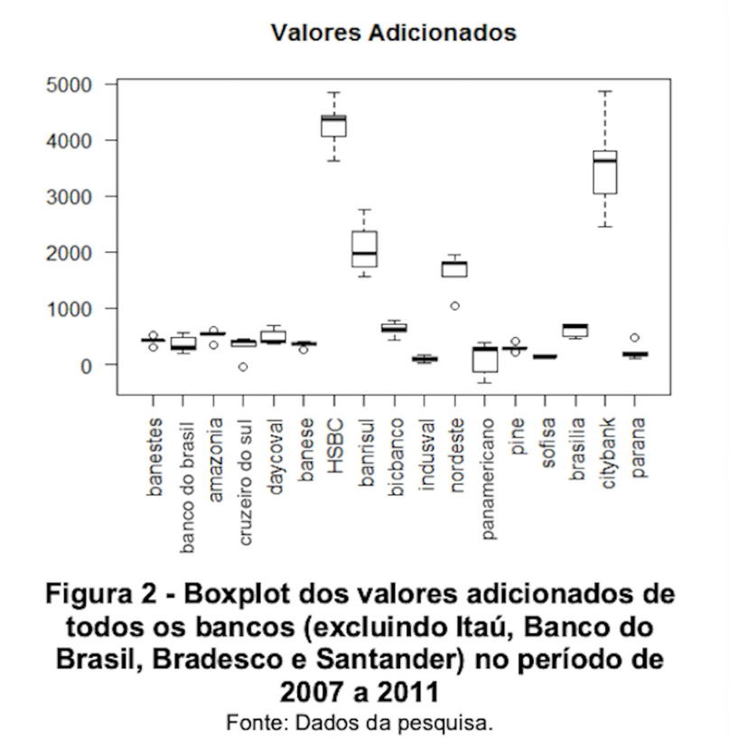
Research Data
Figura 1
Figura 2
Stats tests anova
2024
Boxplot of the added values of all banks
from 2007 to 2011
Boxplot of the added values of all banks
excluding Itaú, Banco do Brasil, Bradesco, and S
Santander) from 2007 to 2011

Slide 13
Analysis with Group Segmentation
- Groups Formed:
- Banks with added values > R$ 5 million: Itaú, Banco do Brasil, Bradesco, Santander
- Banks between R$ 1 and R$ 4.999 million: Banrisul, Citibank, HSBC, Nordeste
Stats tests anova
2024

Slide 14
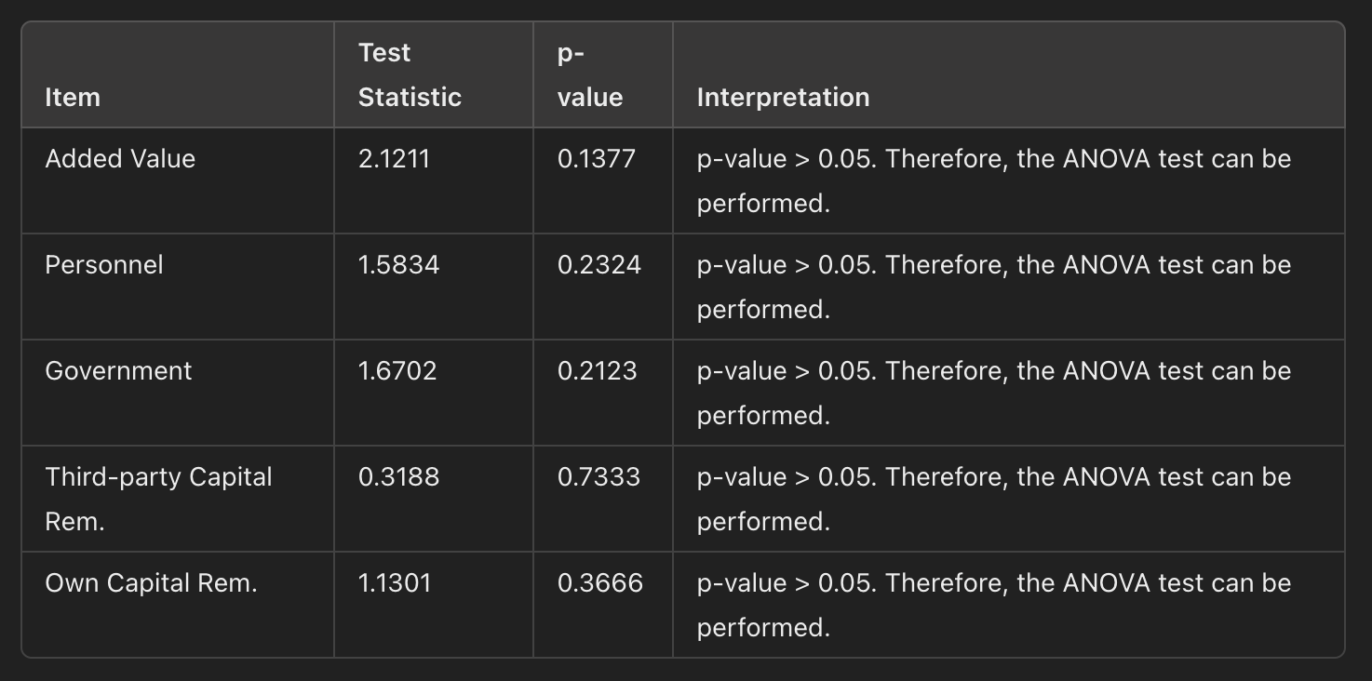
Research Group Division
Table 3 - Levene's F Test for banks with added values above R$ 5 million
Stats tests anova
2024

Slide 15
ANOVA Results Analysis
Above R$ 5 million:
Levene's F Test: All p-values are above 0.05, so ANOVA test can be performed in all categories.
ANOVA Test: The hypothesis of equal means is rejected in almost all categories, cept for Third-Party Capital Remuneration.
In all cases (except the exception), the pairs Itaú and BB, Bradesco and BB have p-values above 5%, while the Bradesco and Santander pair are below.
Stats tests anova
2024

Slide 16
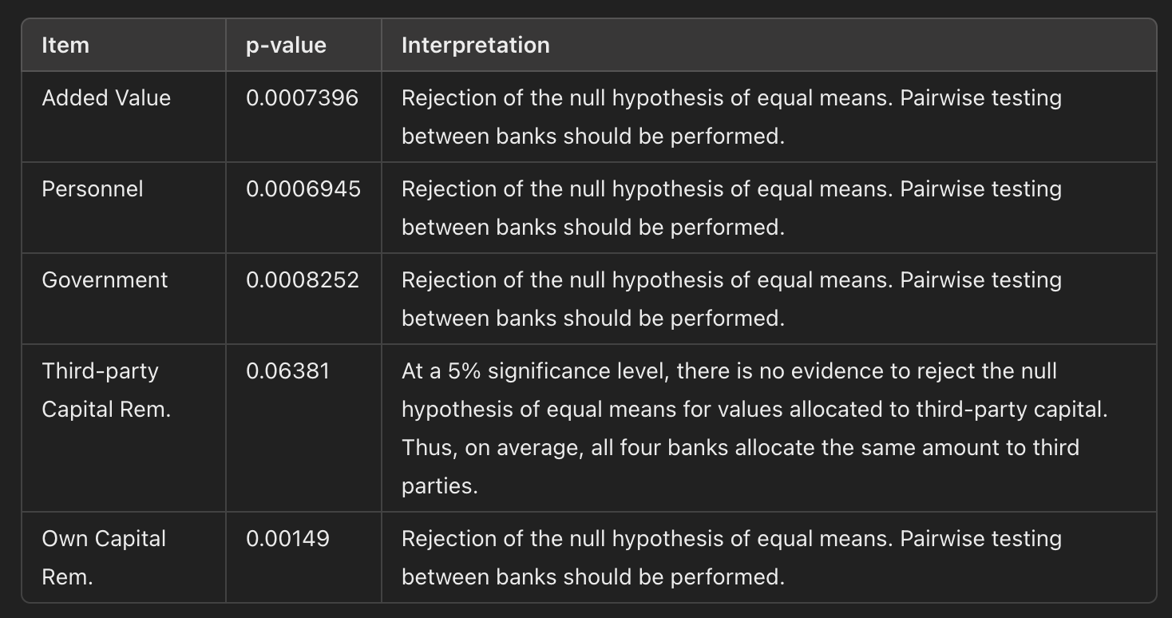
ANOVA Results Analysis
Table 4 - ANOVA p-value for banks with added values above R$ 5 million
Stats tests anova
2024

Slide 17
ANOVA Results Analysis
Between R$ 1 and 5 million:
- Levene's F Test: All p-values are above 0.05, so ANOVA test can be performed in all categories.
- ANOVA Test: The hypothesis of equal means is rejected in almost all categories, except for government.
- p-value > 0.05: Banrisul and Nordeste in added value and personnel. HSBC and Citibank in added value and Own Capital Remuneration.
- p-value < 0.05: Both Nordeste and Citibank, and HSBC and Banrisul in added value and personnel. Also in all cases of Third-Party Capital Remuneration, and Own Capital Remuneration (the latter except for HSBC and Citibank).
Stats tests anova
2024

Slide 18
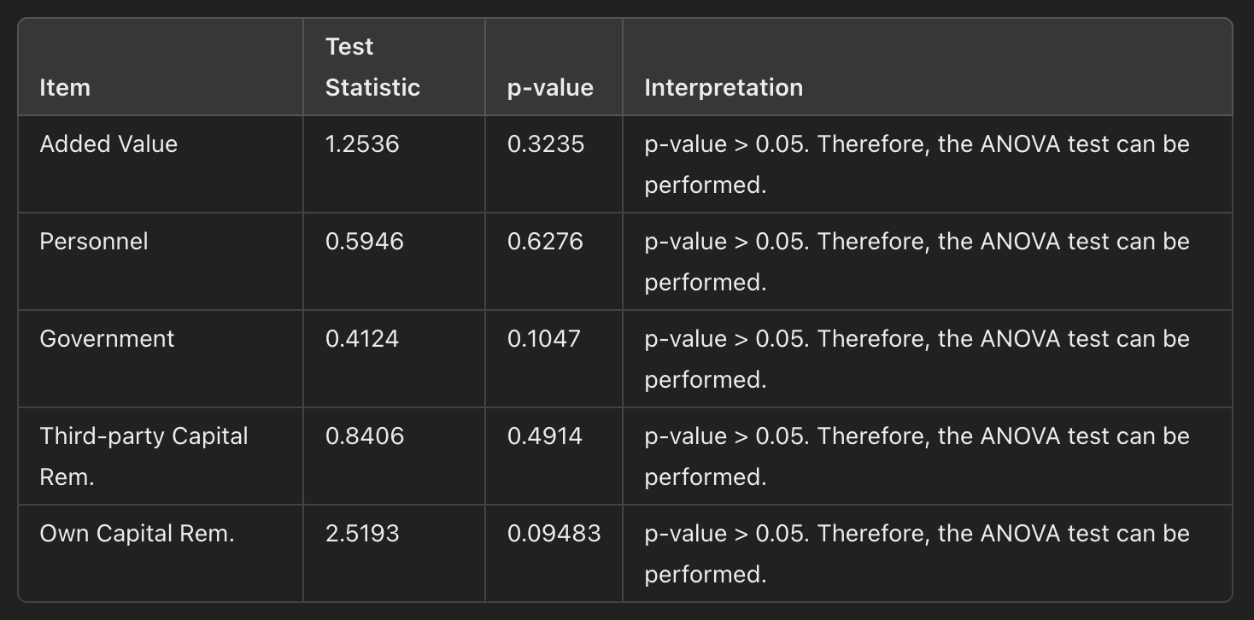
ANOVA Results Analysis
Table 5: Levene's F Test for banks with added values between R$ 1 and R$ 4.99 million
Stats tests anova
2024

Slide 19
ANOVA Results Analysis
Table 5: Levene's F Test for banks with added values between R$ 1 and R$ 4.99 million
Stats tests anova
2024

Slide 20
Conclusions and Reflections
This study analyzed the creation and distribution of added value by banks listed on BOVESPA (2007-2011), comparing wealth distribution between foreign and national banks through Analysis of Variance (ANOVA).
Significant differences were observed, especially in remuneration policies and tax burden among banks.
Santander and HSBC adopt different remuneration strategies for their employees.
Santander shows a higher tax burden and differs in terms of added value, own capital remuneration, and taxes, although similar to Bradesco regarding personnel remuneration.
Stats tests anova
2024

Slide 21
Reflections and Implications
HSBC differs in the distribution of value to personnel, while own capital remuneration is equal between HSBC and Citibank, as well as between Banrisul and Banco do Nordeste.
The similarities between Banco Itaú (private) and Banco do Brasil (public) show an unexpected alignment in value distribution.
Reflection: There is an urgent need for greater alignment in social and environmental responsibility practices and greater equity in wealth distribution among banks in Brazil.
Stats tests anova
2024

Slide 22
made with vibe, frequency and joy
follow us on github

